Slide 1
Ethyl 4-methyl-4-(4,4,5,5-tetramethyl-1,3,2-dioxaborolan-2-yl)octanoate (4ba)
¹H NMR (300 MHz)

Slide 2
Ethyl 4-methyl-4-(4,4,5,5-tetramethyl-1,3,2-dioxaborolan-2-yl)octanoate (4ba)
¹¹B NMR (96 MHz)

Slide 3
Ethyl 4-methyl-4-(4,4,5,5-tetramethyl-1,3,2-dioxaborolan-2-yl)octanoate (4ba)
¹³C NMR (75 MHz)

Slide 4
Ethyl 4-methyl-4-(4,4,5,5-tetramethyl-1,3,2-dioxaborolan-2-yl)octanoate (4ba)
DEPT-135 NMR (75 MHz)

Slide 5
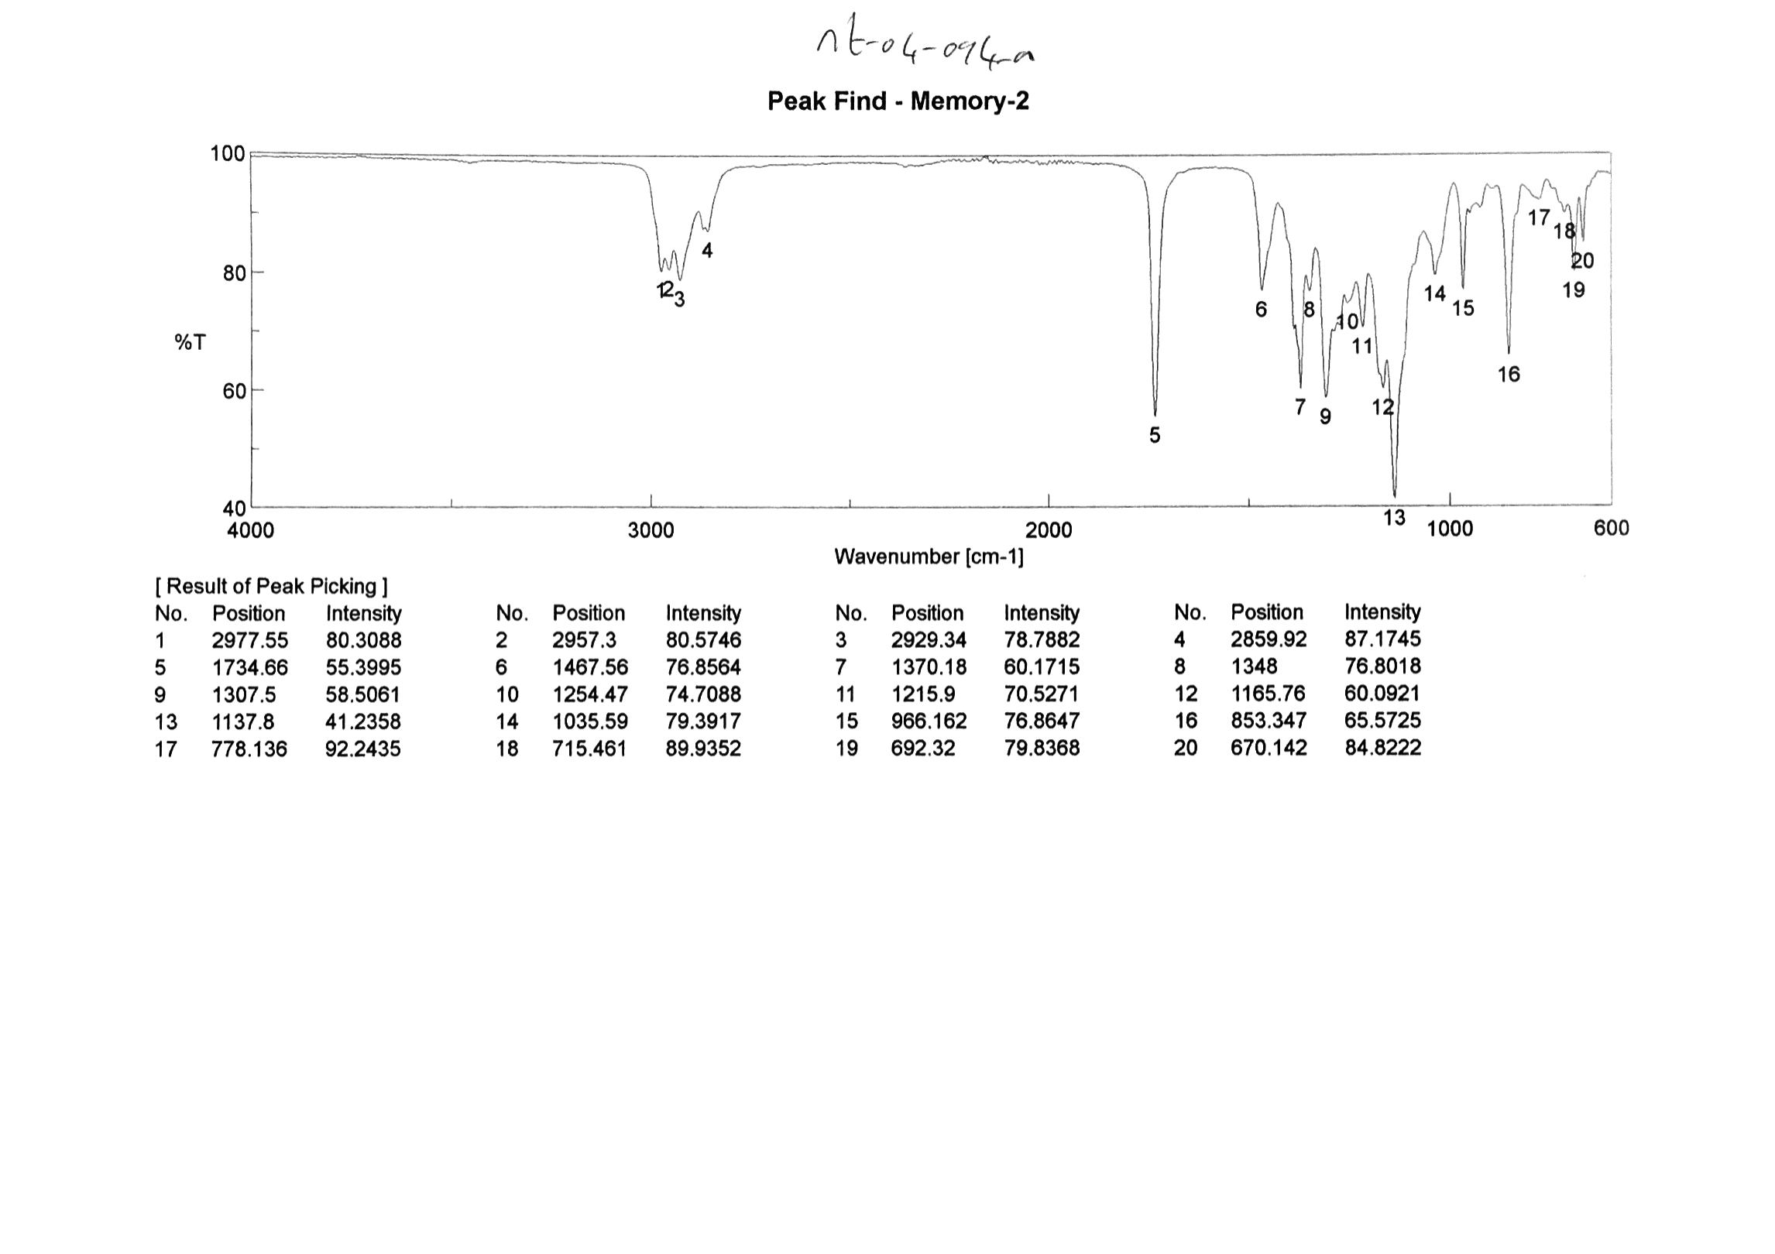
Ethyl 4-methyl-4-(4,4,5,5-tetramethyl-1,3,2-dioxaborolan-2-yl)octanoate (4ba)
FTIR

